Slide 1




PROBLEM SOLVING PROCESS
Class IX
lab 6

Slide 2
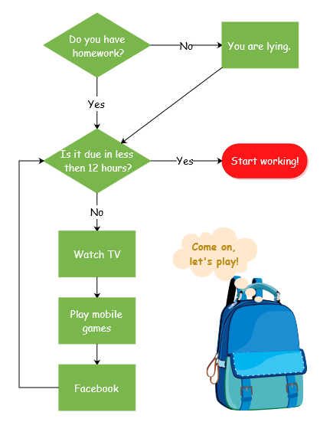
Flowchart
Flowcharts are used in analyzing, designing, documenting or managing a process or program

Slide 3
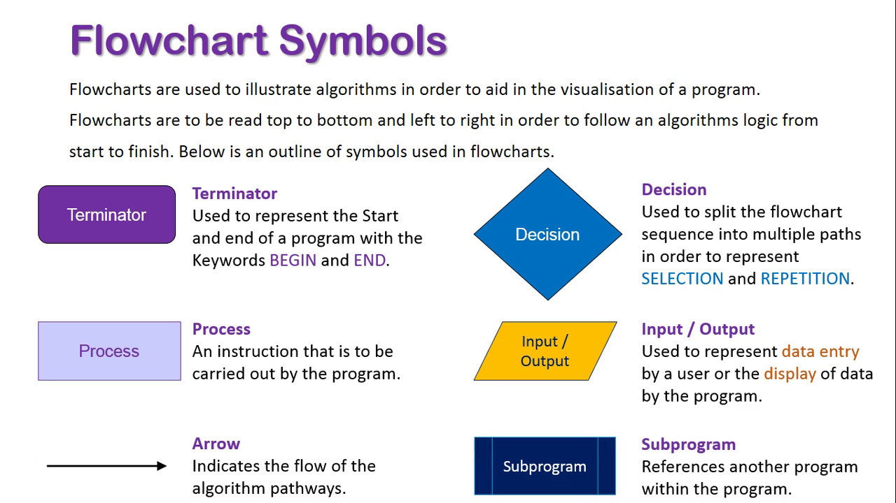
Flowchart Symbols

Slide 4
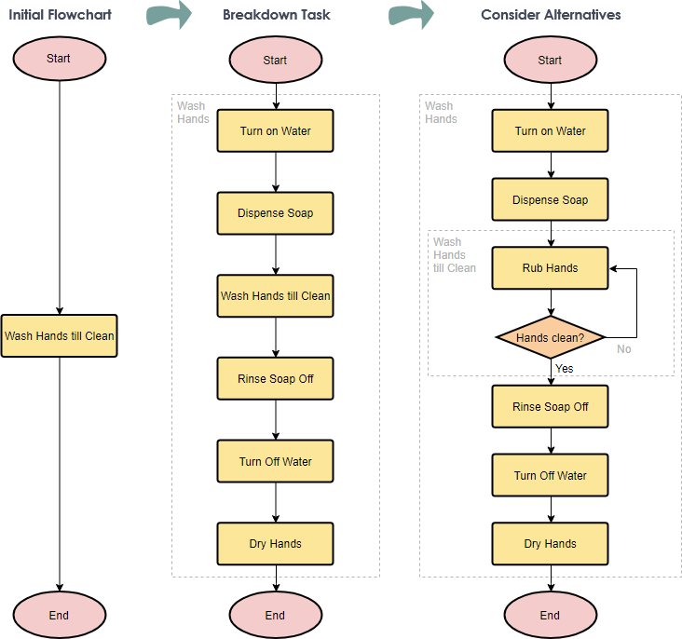
Hand Washing Example

Slide 5
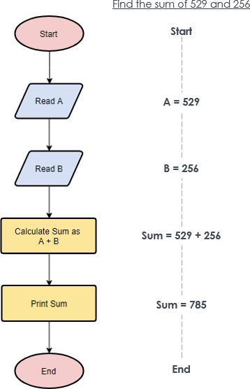
Simple Algorithms

Slide 6
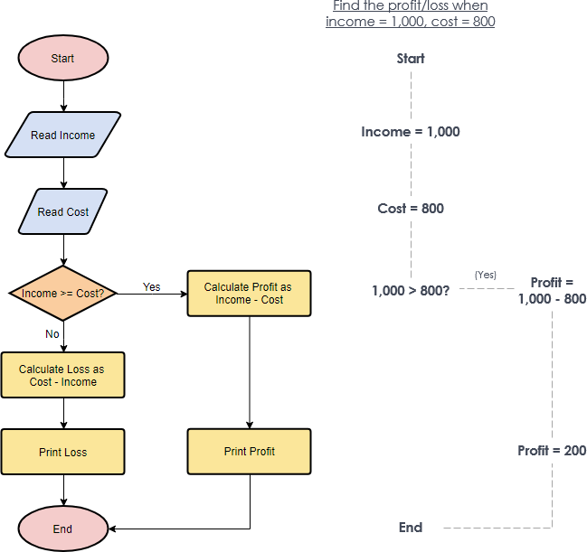
Calculate Profit and Loss

Slide 7
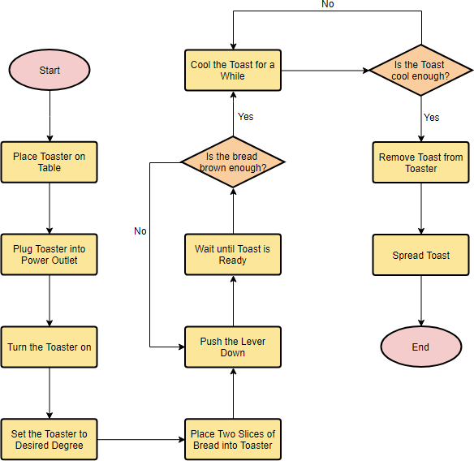
Make a Toast

Slide 8



